Slide 1
Deep Active Learning
Learn Effectively!

Slide 2
Cifar 10
Stanford NLP
Face Emotions
10 Different classes
Fashion MNIST
10 Different Classes (Clothes and Accessories)
Premis, Conclusion -> Natural, Contradiction, Entailment
8 Classes represents different facial emotions

Slide 3
Table of contents
01
02
03
04
05
06
Deep Learning Architecture
Accuracy Measures before AL
The Effect of each AL strategy
Accuracy Measures after AL
Notes and Challenges
Additional Improvements done

Slide 4
Cifar 10

Slide 5
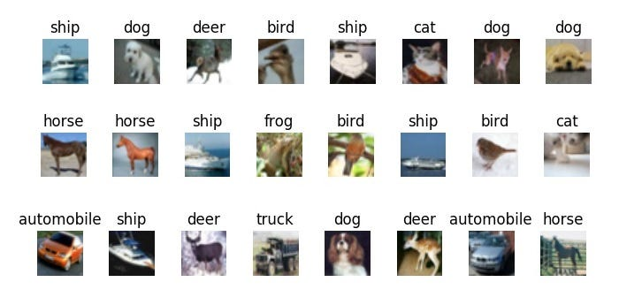
Classes : 10
Dimension: 32*32*3
Samples : 60,000

Slide 6
01
Deep Learning Architecture

Slide 7

Resnet Architecture
Innovation: Introduces residual connections for deep network training.
Architecture: 50 layers structured around residual blocks. (50M Parameters)
Efficiency: Allows efficient learning of complex representations.
Performance: State-of-the-art results in image classification.
Applicability: Widely used across various computer vision tasks.

Slide 8
02
Accuracy Measures before AL

Slide 9
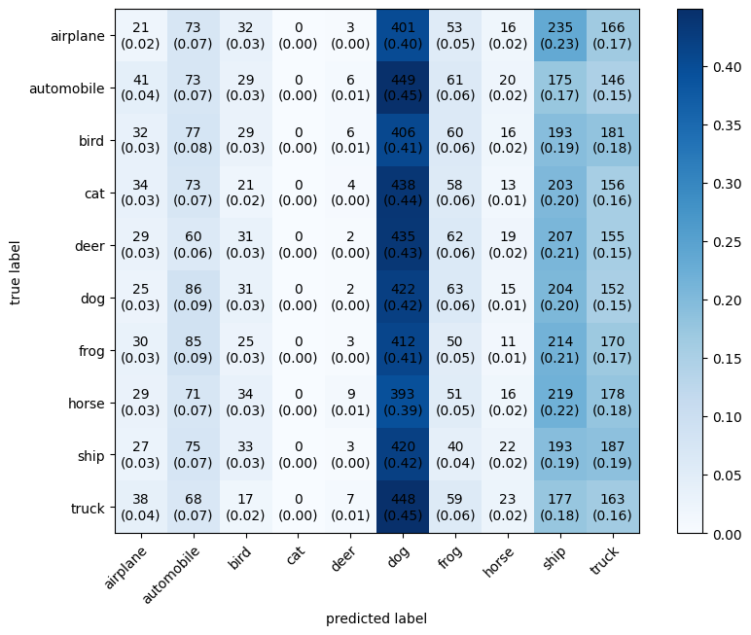
Confusion Matrix

Slide 10
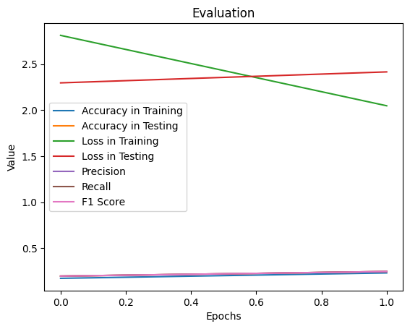
Evaluation Metrics

Slide 11
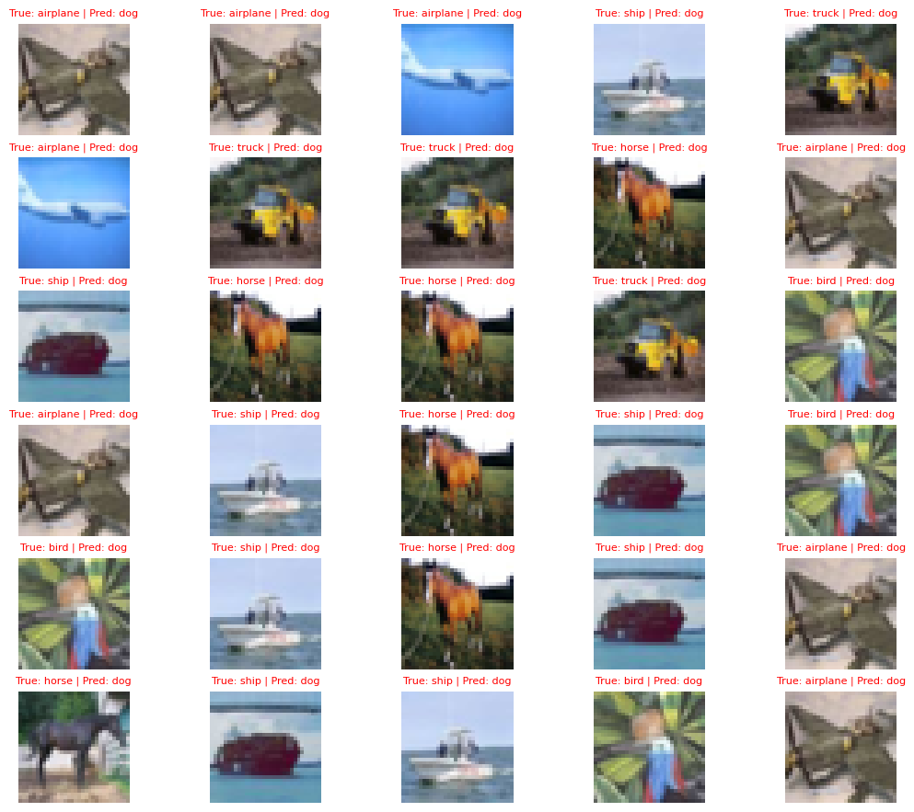
Visual Evaluation

Slide 12
03
The Effect of each AL strategy

Slide 13
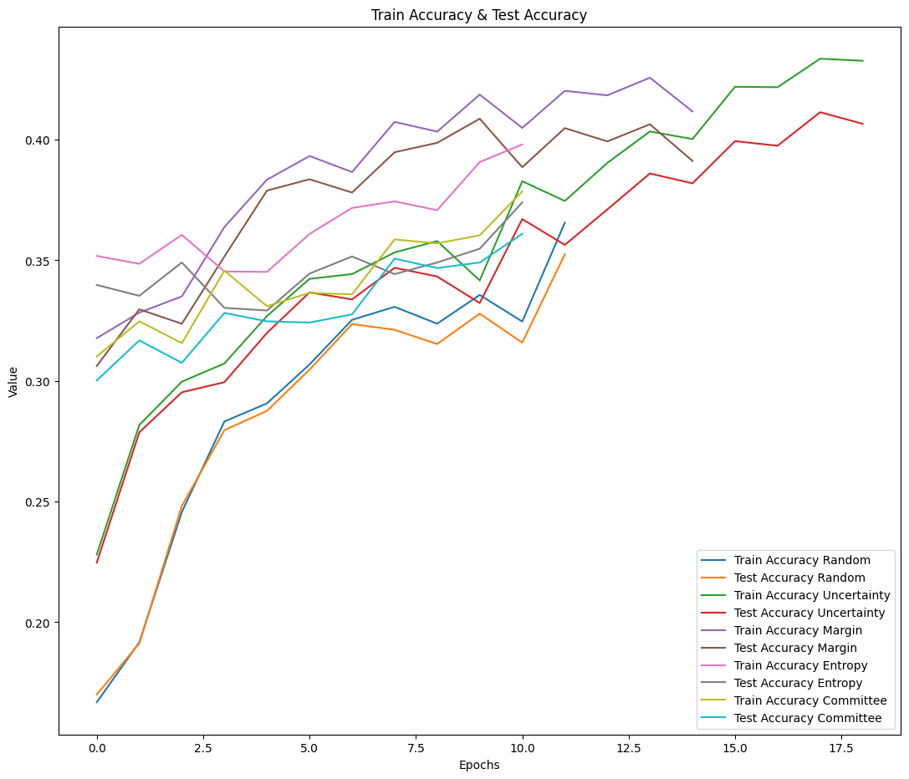
Accuracy

Slide 14
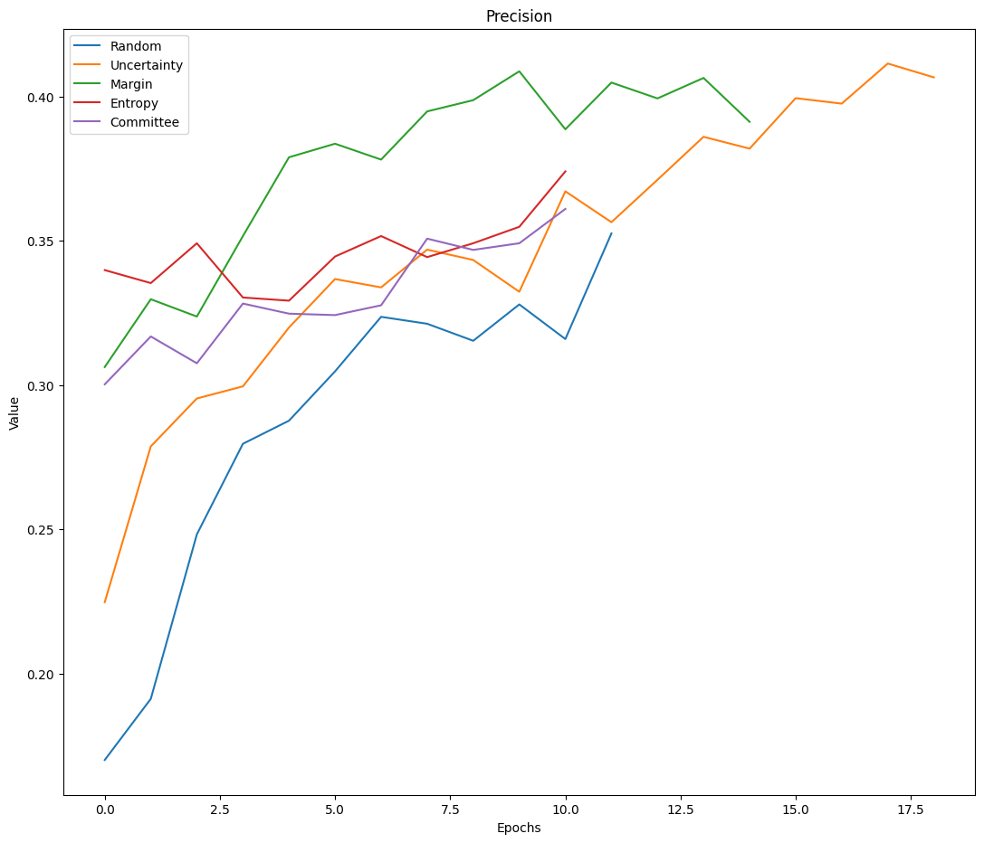
Precision

Slide 15
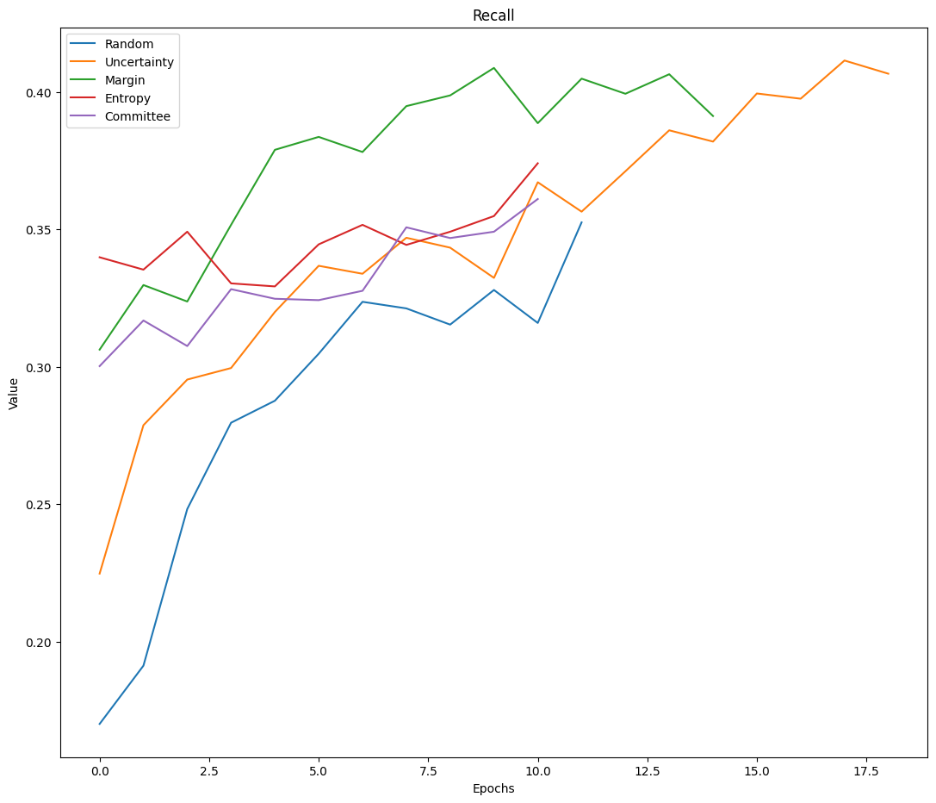
Recall

Slide 16

F1 Score

Slide 17
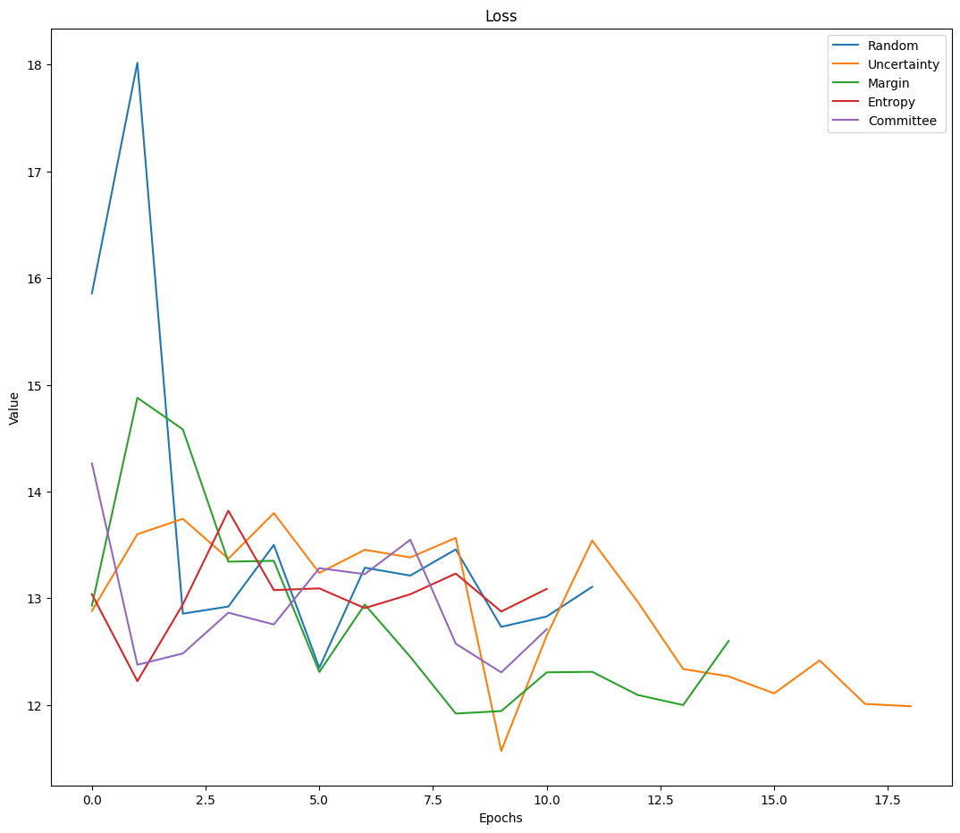
Loss

Slide 18
04
Accuracy Measures after AL

Slide 19
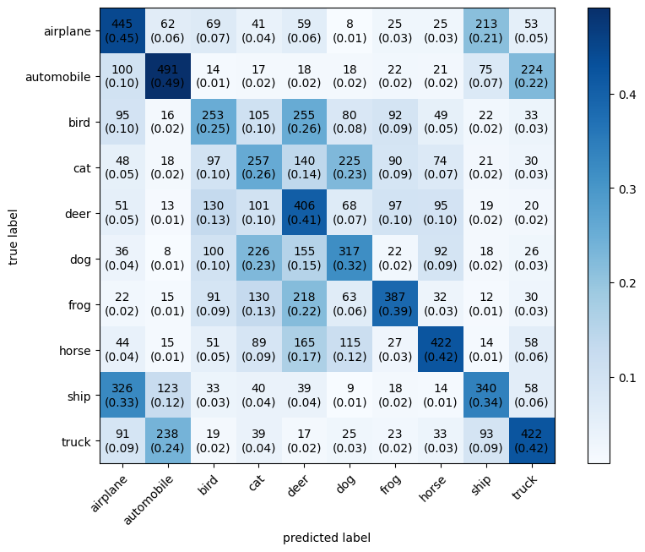
Entropy Based Sampling

Slide 20
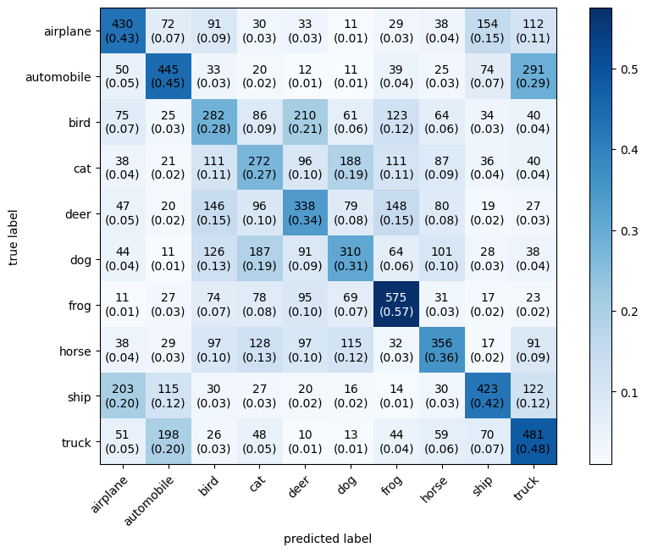
Margin Sampling

Slide 21
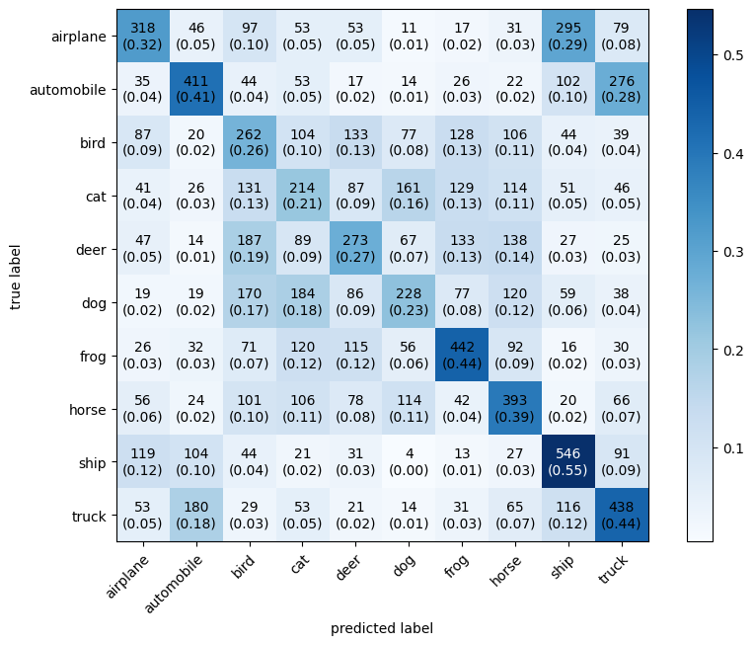
Random Sampling

Slide 22
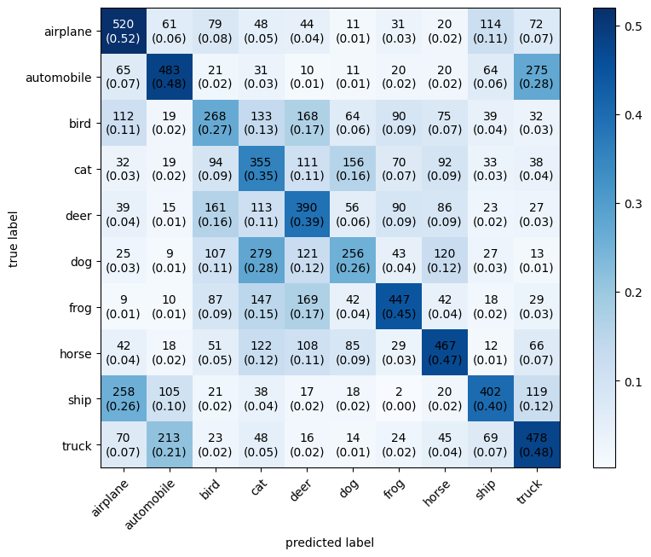
Uncertainty Sampling

Slide 23
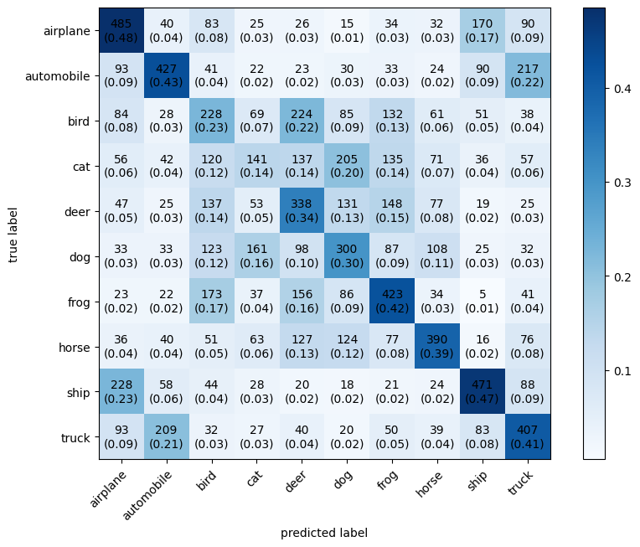
Query By Committee

Slide 24
05
Notes and Challenges

Slide 25

Notes and Challenges
D-type Compatibility Problem
Solution
The default dtype of pytorch datasets is (torch.Float) for some datasets and (torch.Int) for others.
The default dtpye is not complatiple with the ModAl package
We had to convert the dtype of the dataset into (torch.float32)
Really?!

Slide 26
Notes and Challenges
Managing Devices
Solution
There was a problem to unify the device between the pytorch model and dataset and the Modal learner
Data has to be transferred manually between devices in Modal

Slide 27
06
Additional Improvements done

Slide 28
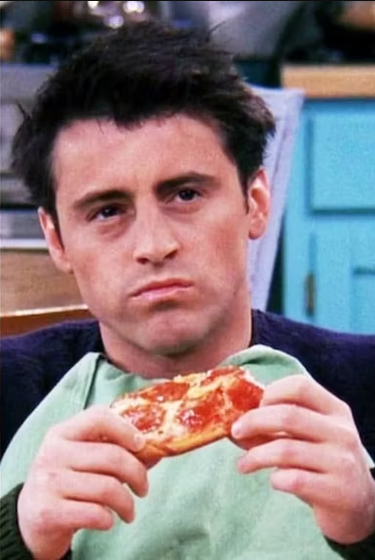
No Improvements!

Slide 29
Fashion MNIST

Slide 30
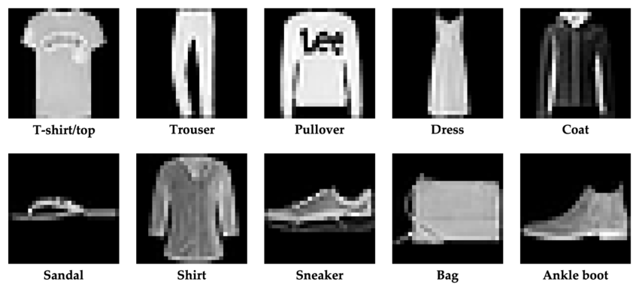
Classes : 10
Dimension: 28*28*3
Samples : 10,000

Slide 31
01
Deep Learning Architecture

Slide 32

Resnet Architecture
Innovation: Introduces residual connections for deep network training.
Architecture: 50 layers structured around residual blocks. (50M Parameters)
Efficiency: Allows efficient learning of complex representations.
Performance: State-of-the-art results in image classification.
Applicability: Widely used across various computer vision tasks.

Slide 33
02
Accuracy Measures before AL

Slide 34
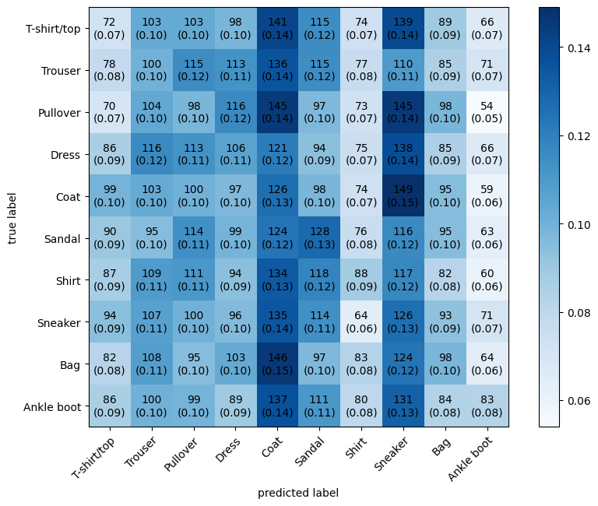
Confusion Matrix

Slide 35
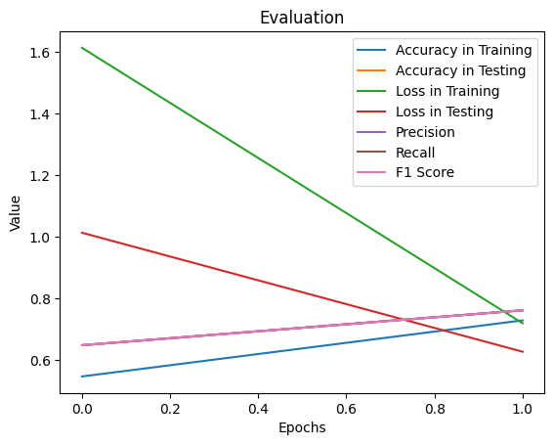
Evaluation Metrics

Slide 36
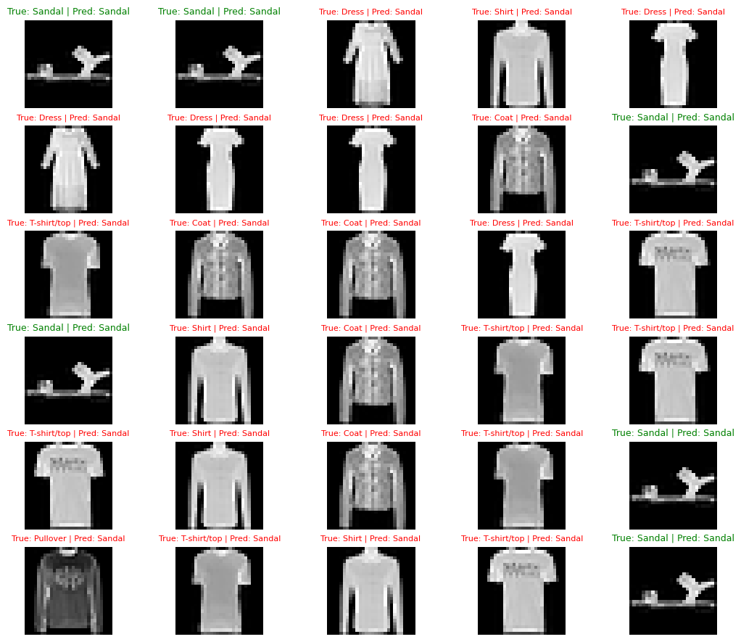
Visual Evaluation

Slide 37
03
The Effect of each AL strategy

Slide 38
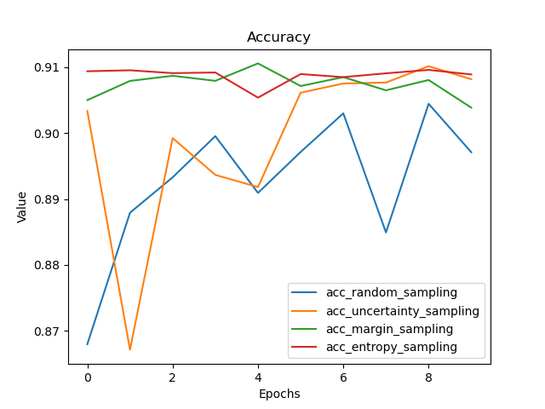
Accuracy

Slide 39
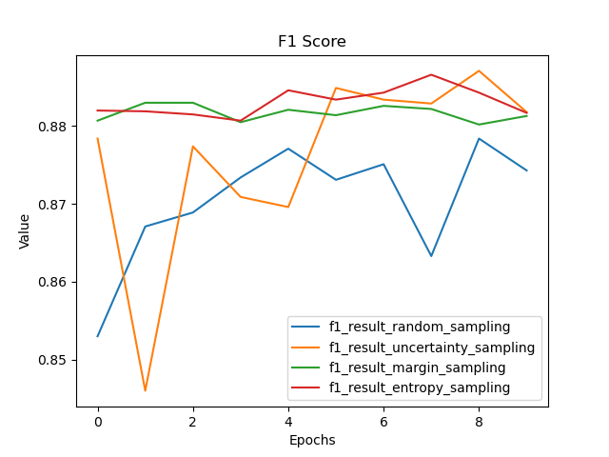
F1 Score

Slide 40
04
Accuracy Measures after AL

Slide 41
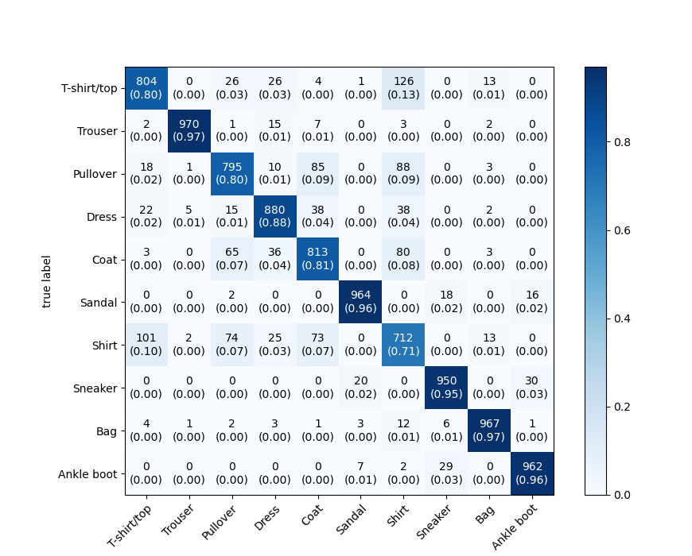
Entropy Based Sampling

Slide 42
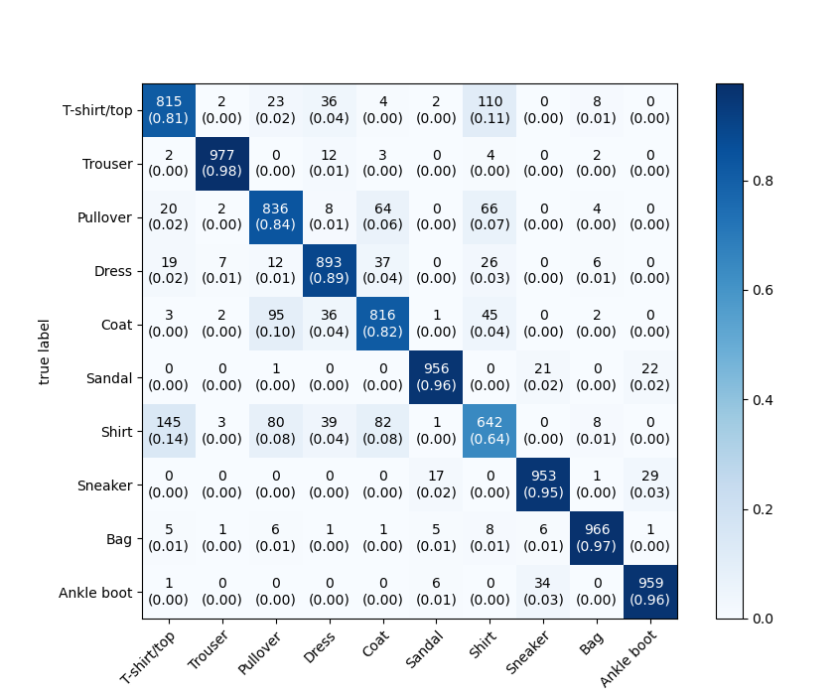
Margin Sampling

Slide 43
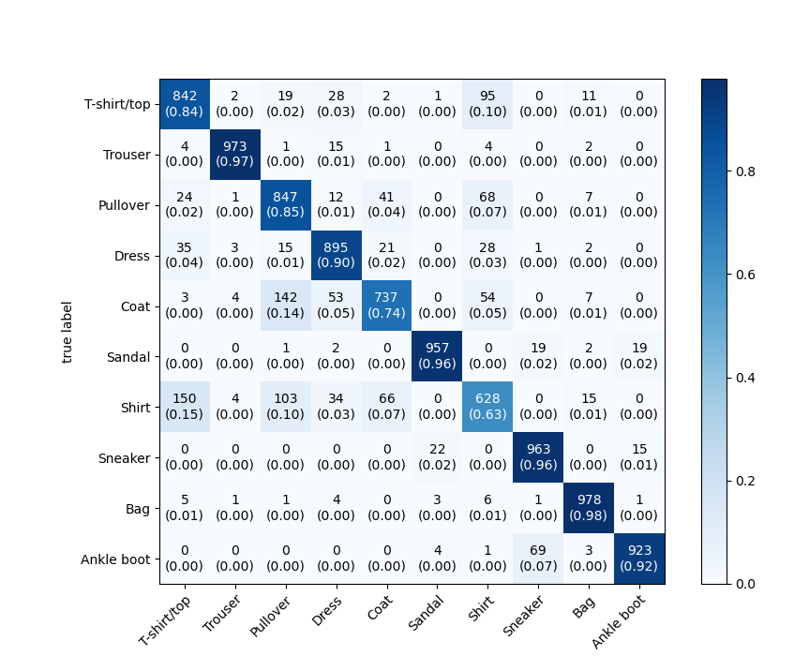
Random Sampling

Slide 44
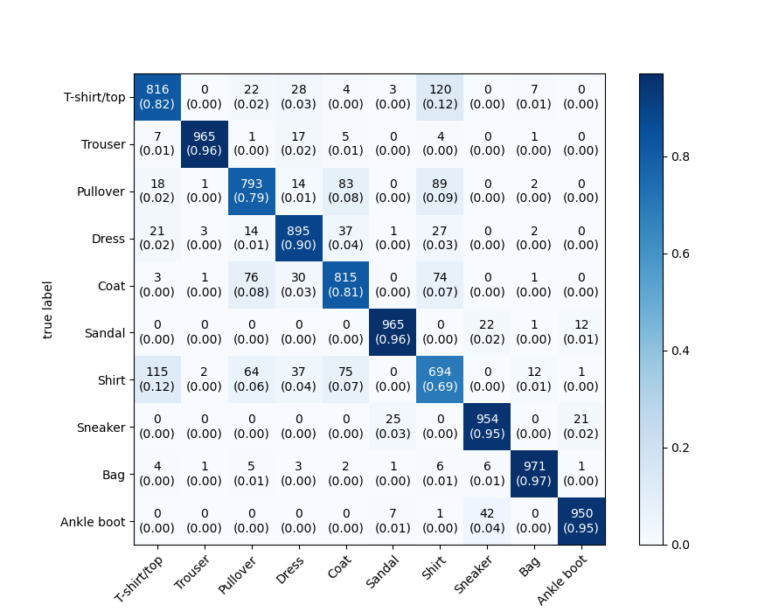
Uncertainty Sampling

Slide 45
05
Notes and Challenges

Slide 46
Notes and Challenges
D-type Compatibility Problem
Solution
The default dtype of pytorch datasets is (torch.Float) for some datasets and (torch.Int) for others.
The default dtpye is not complatiple with the ModAl package
We had to convert the dtype of the dataset into (torch.float32)
Really?!

Slide 47
Notes and Challenges
Managing Devices
Solution
There was a problem to unify the device between the pytorch model and dataset and the Modal learner
Data has to be transferred manually between devices in Modal

Slide 48
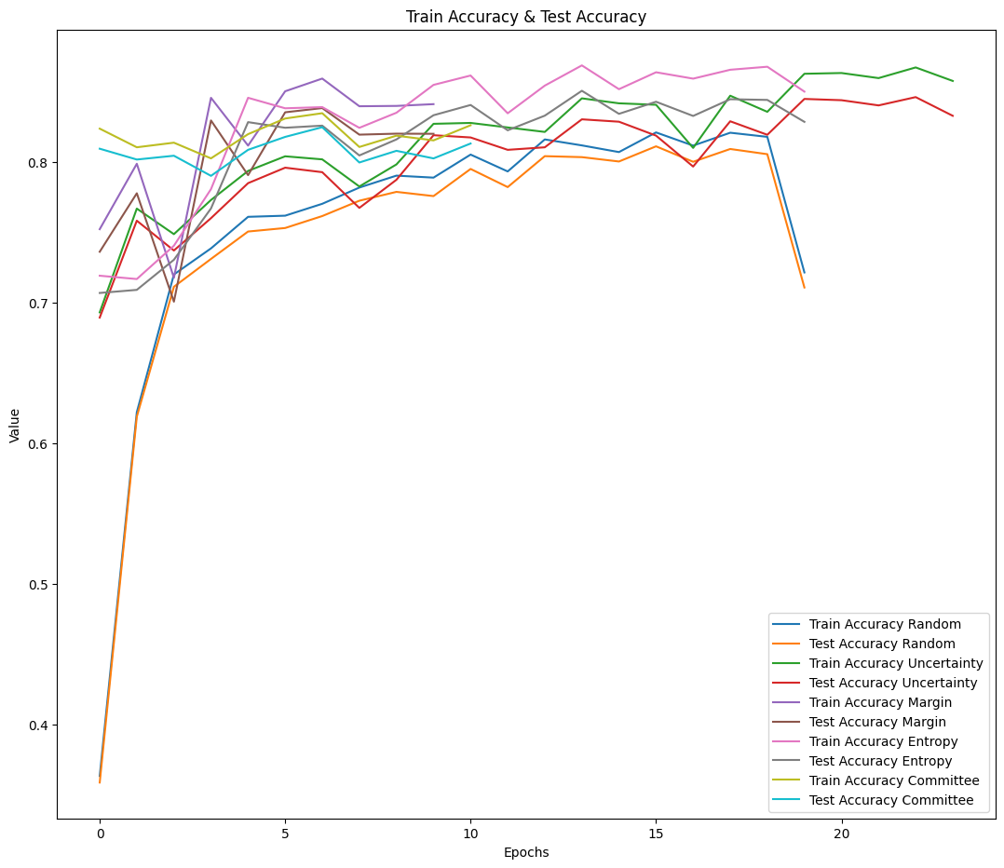
Accuracy

Slide 49
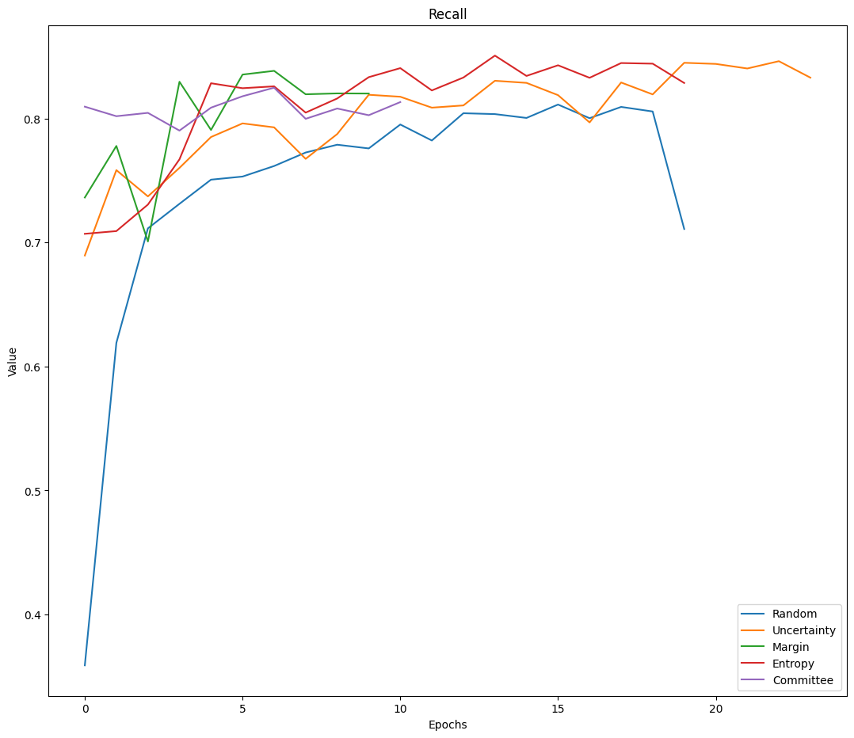
Recall

Slide 50
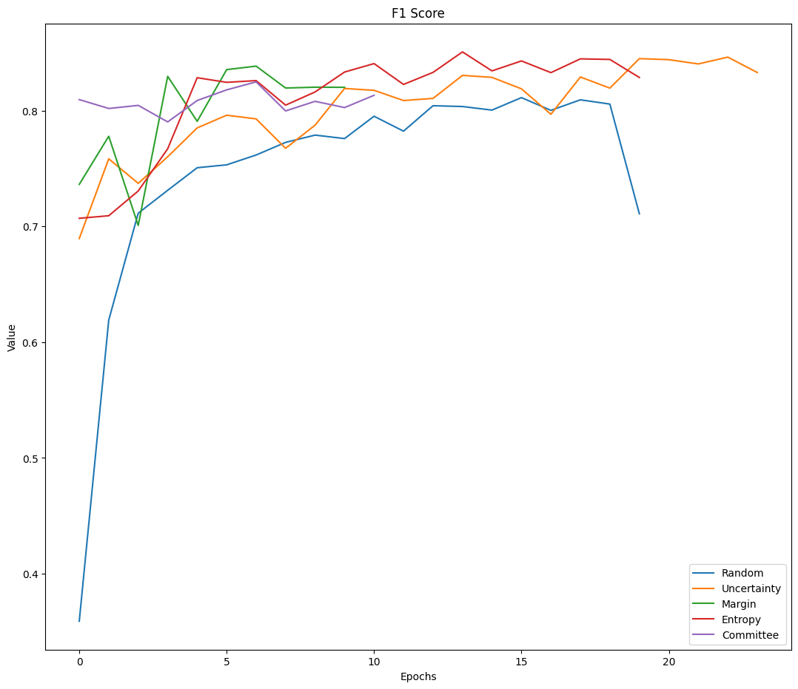
F1 Score

Slide 51
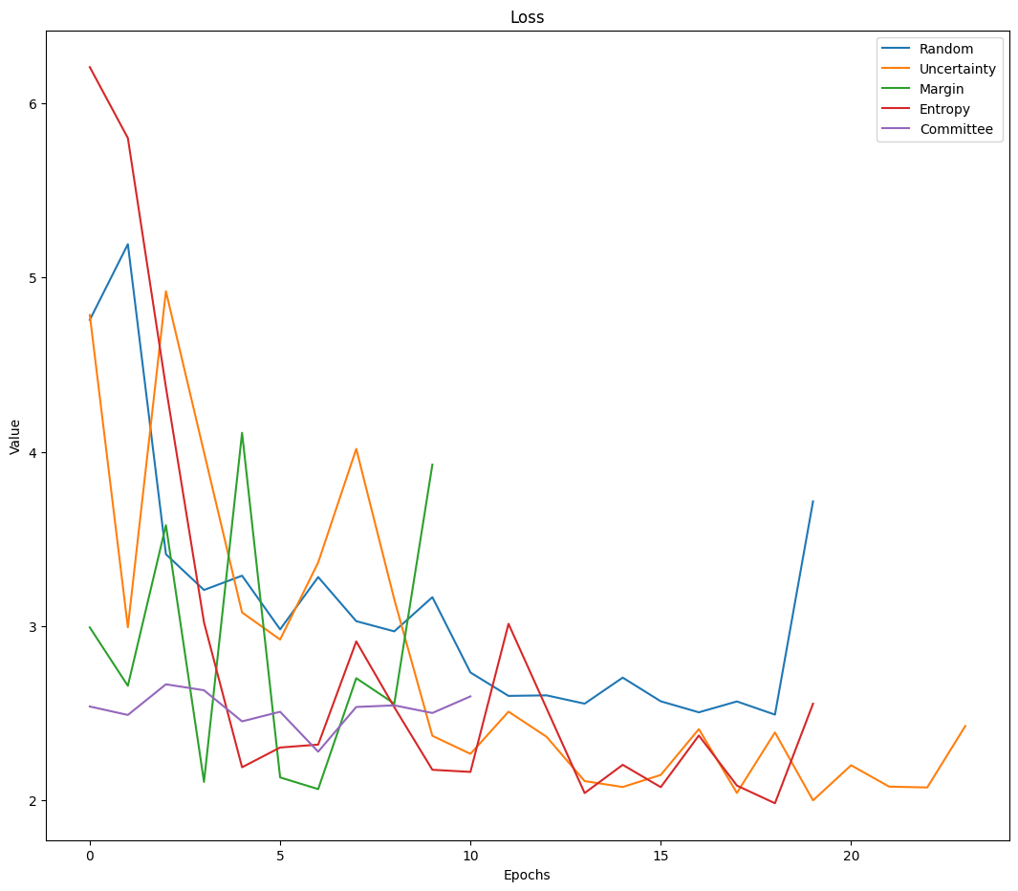
Loss

Slide 52
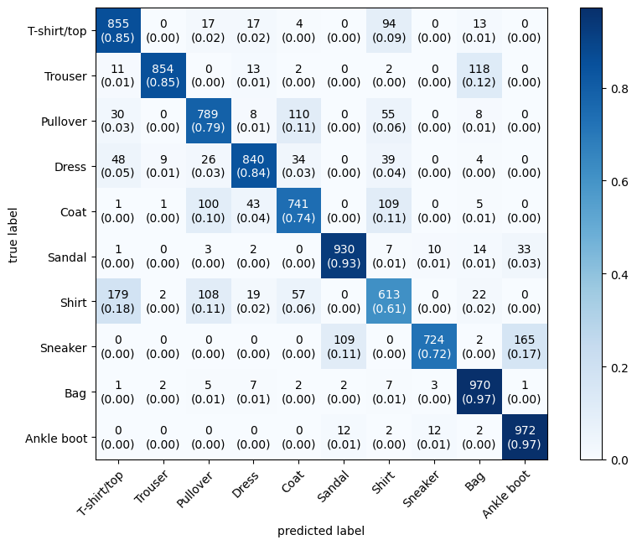
Entropy Based Sampling

Slide 53
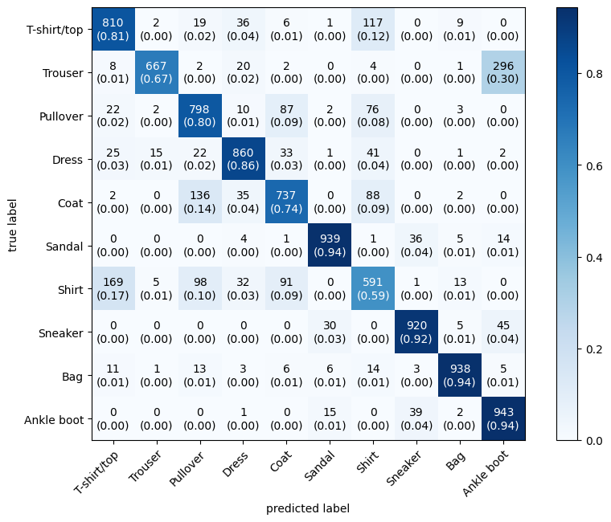
Margin Sampling

Slide 54
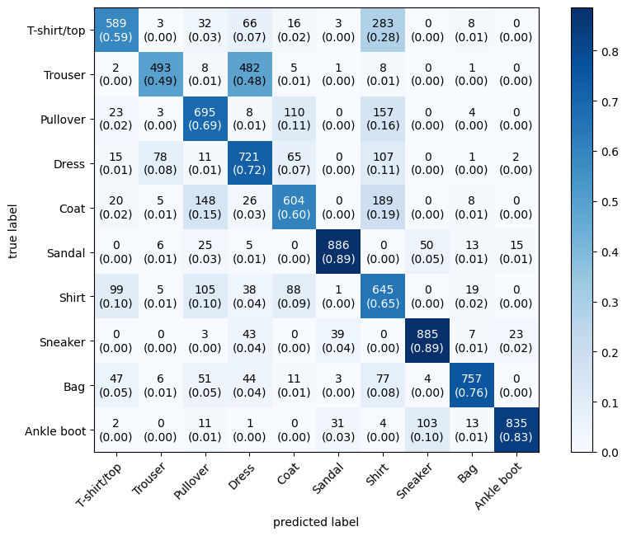
Random Sampling

Slide 55
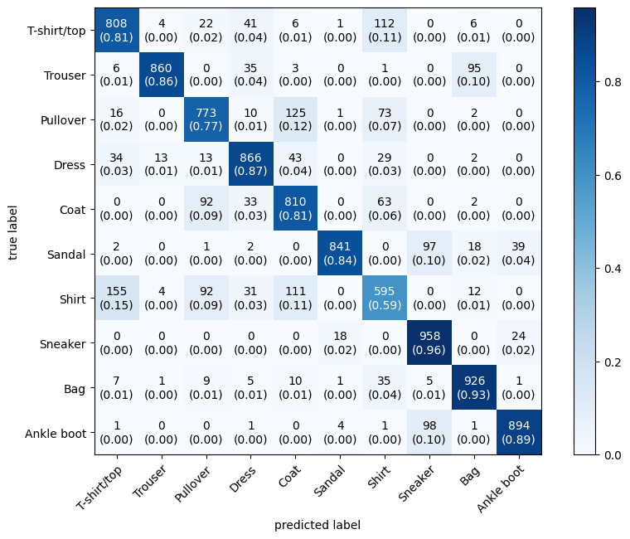
Uncertainty Sampling

Slide 56
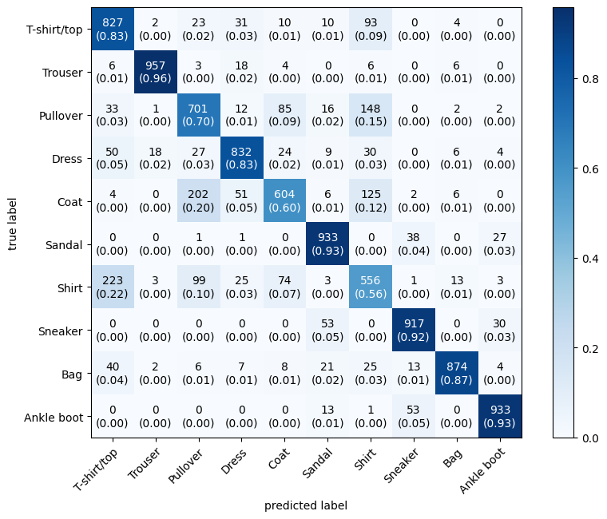
Query by Committee

Slide 57
06
Additional Improvements done

Slide 58
No Improvements!

Slide 59
Stanford NLP

Slide 60
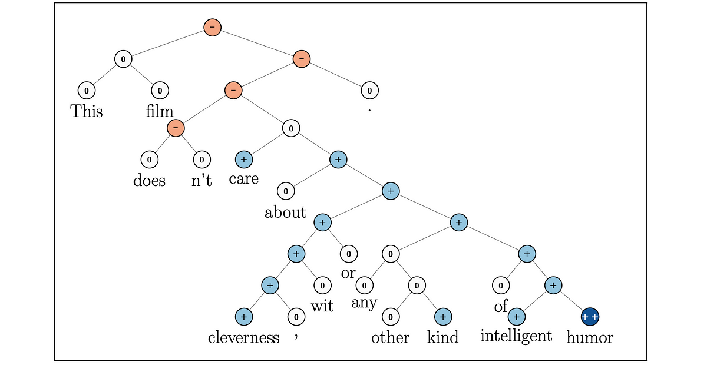
A collection of 570k human-written English sentence pairs manually labeled for balanced classification with the labels entailment, contradiction, and neutral.

Slide 61
01
Deep Learning Architecture

Slide 62
Logistic Regression
Innovation: Introduces a streamlined approach to binary classification through logistic regression.
Architecture: A simple yet powerful linear model consisting of a single layer of trainable parameters.
Efficiency: Efficiently learns decision boundaries between classes in data space.
Performance: Provides reliable performance for binary classification tasks, particularly when the data exhibits linear separability.

Slide 63
02
Accuracy Measures before AL

Slide 64
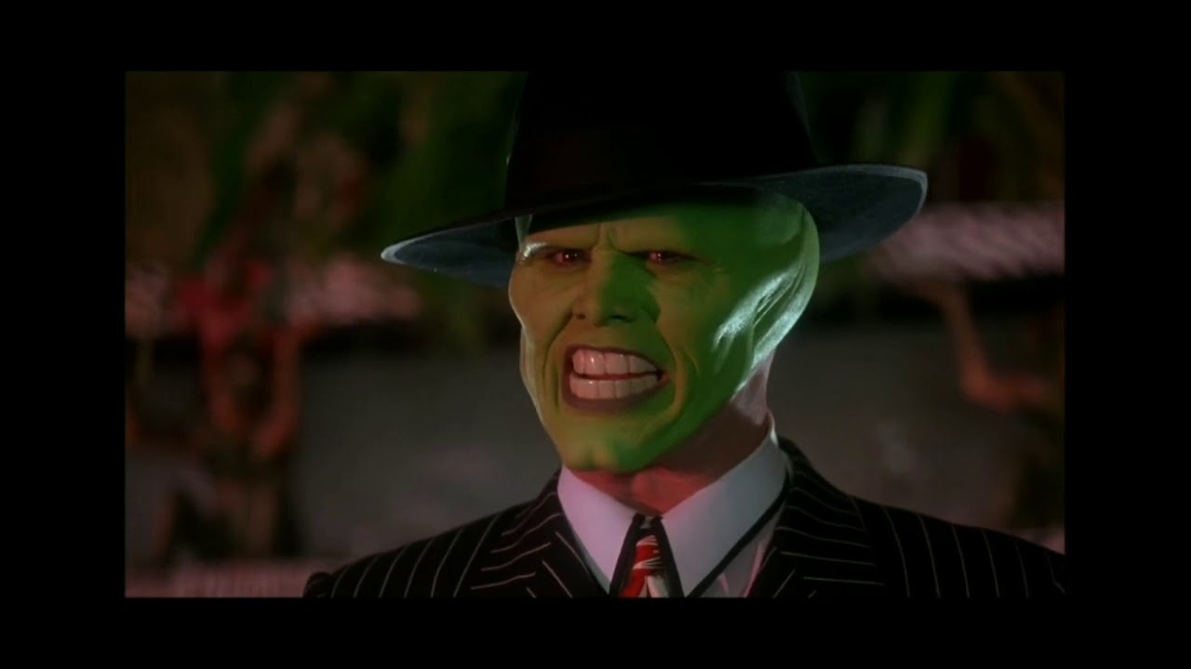

Resnet Architecture
Innovation: Introduces residual connections for deep network training.
Architecture: 50 layers structured around residual blocks. (50M Parameters)
Efficiency: Allows efficient learning of complex representations.
Performance: State-of-the-art results in image classification.
Applicability: Widely used across various computer vision tasks.
Did You Miss
Me?!

Slide 65
Before Active Learning:
Training accuracy: 0.8775
Score: 0.8467
Precision: 0.858693
Recall: 0.82776659

Slide 66
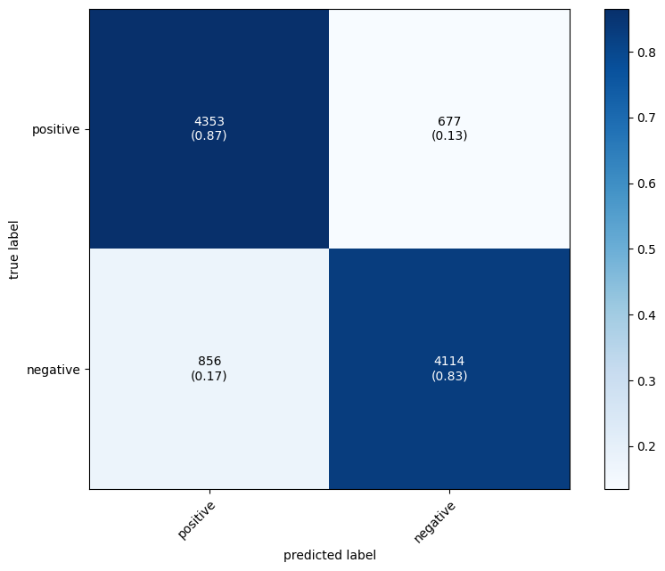
Confusion Matrix

Slide 67
03
The Effect of each AL strategy

Slide 68
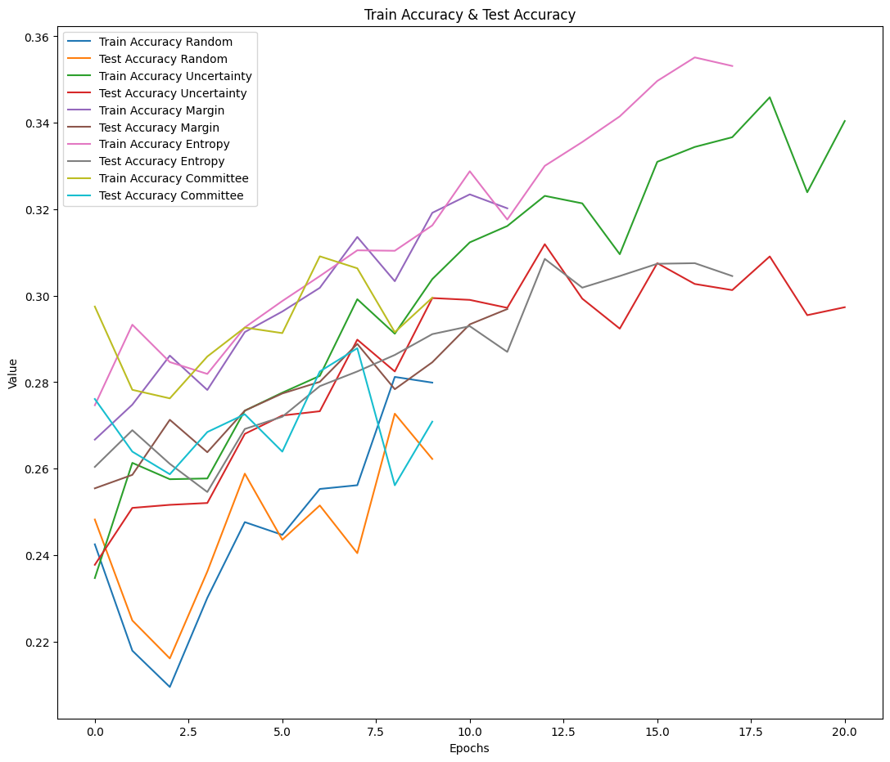
Accuracy

Slide 69
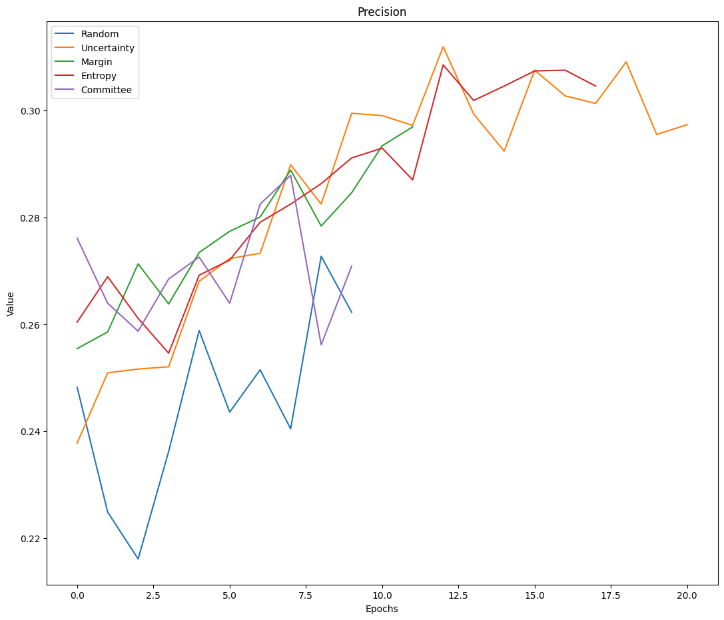
Precision

Slide 70
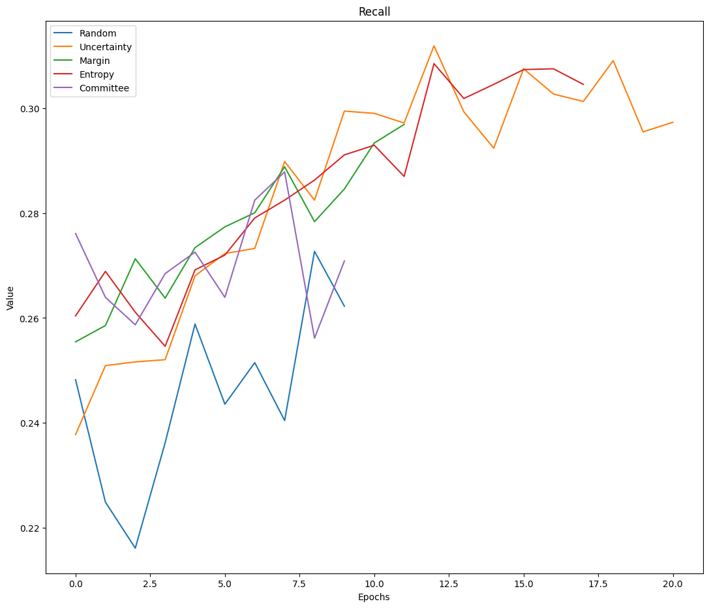
Recall

Slide 71

F1 Score

Slide 72
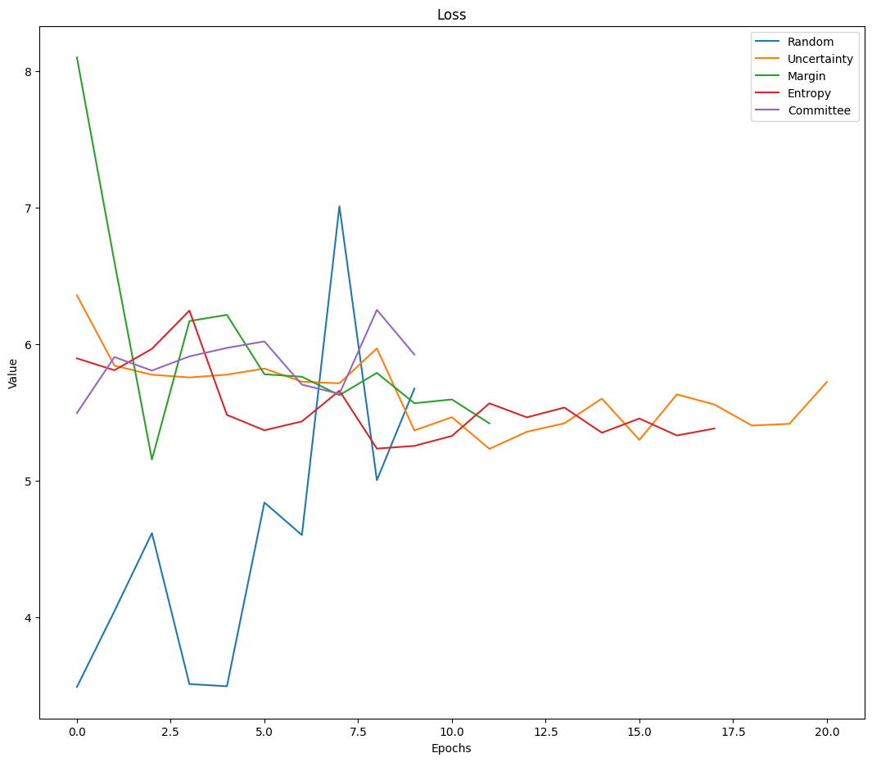
Loss

Slide 73
After 10 Cycles:
Random : 0.2622417211532593
Uncertainty: 0.29733937978744507
Margin : 0.29691481590270996
Entropy : 0.30455702543258667
Committee : 0.27087461948394775

Slide 74
04
Accuracy Measures after AL

Slide 75
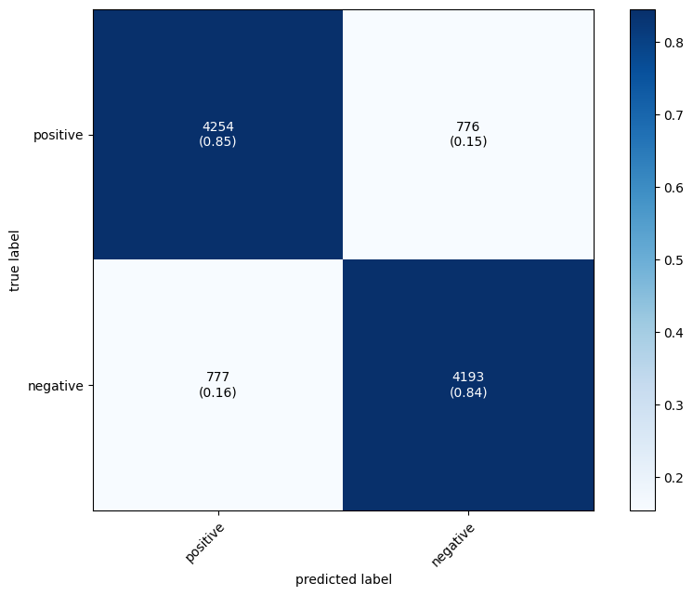
Entropy Based Sampling

Slide 76

Margin Sampling

Slide 77

Random Sampling

Slide 78

Uncertainty Sampling

Slide 79
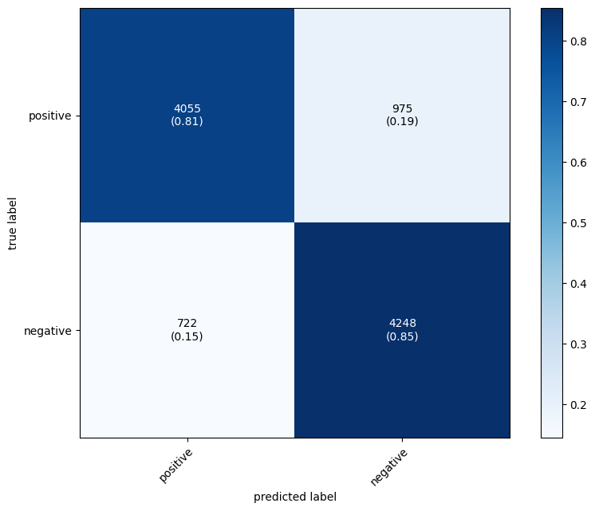
Query By Committee

Slide 80
05
Notes and Challenges

Slide 81

Notes and Challenges
Takes Too long
Solution
Although the model used is too simple, applying active learning using ModAl took much time
patience

Slide 82
06
Additional Improvements done

Slide 83
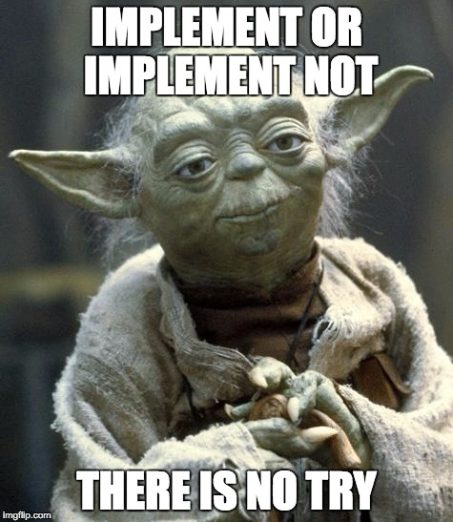
No Improvements!

Slide 84
Face Emotion Recognition

Slide 85
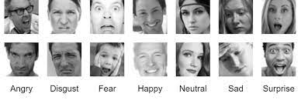
Classes : 8
Dimension: 48*48*1
Samples : 30,000

Slide 86
01
Deep Learning Architecture

Slide 87
02
Accuracy Measures before AL

Slide 88
Resnet Architecture
Innovation: Introduces residual connections for deep network training.
Architecture: 50 layers structured around residual blocks. (50M Parameters)
Efficiency: Allows efficient learning of complex representations.
Performance: State-of-the-art results in image classification.
Applicability: Widely used across various computer vision tasks.

Slide 89
Before Active Learning:
Training loss: 1.930 Training accuracy: 0.233
Testing Loss: 8.017 Testing accuracy: 0.258 F1 Score: 0.258
Precision: 0.258
Recall: 0.258

Slide 90
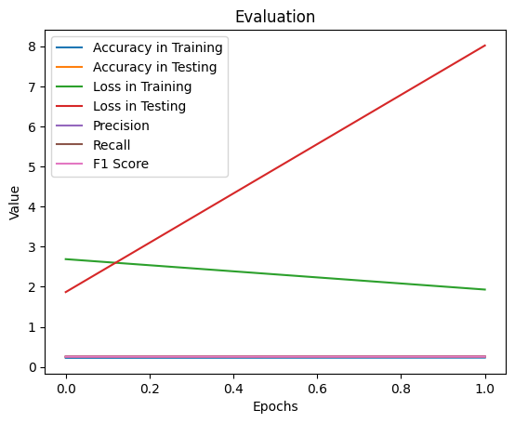
Evaluation Metrics

Slide 91
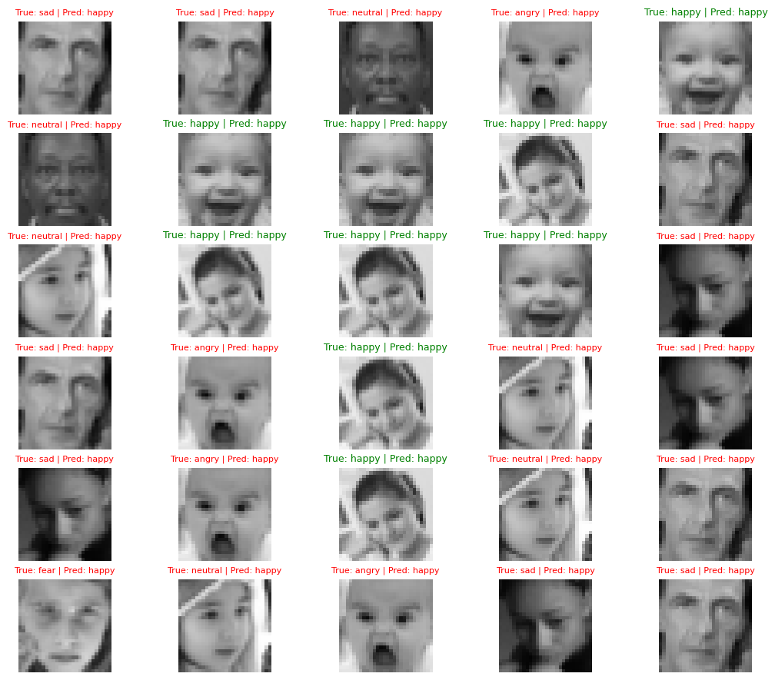
Visual Evaluation

Slide 92
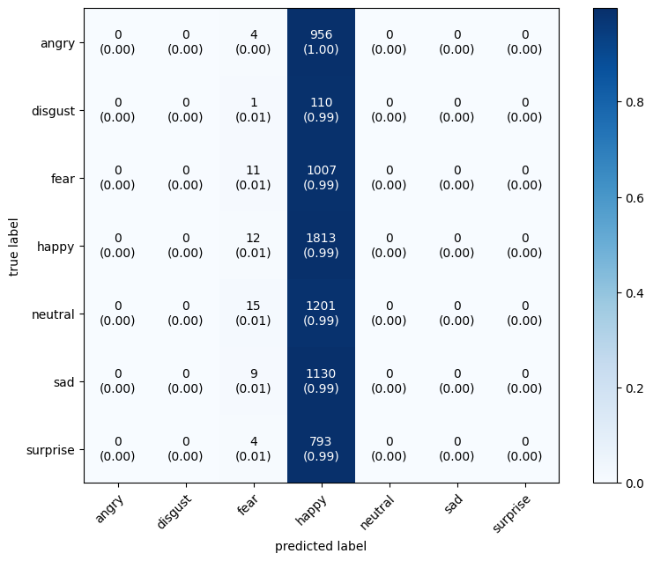
Confusion Matrix

Slide 93
03
The Effect of each AL strategy

Slide 94
Accuracy

Slide 95
Precision

Slide 96
Recall

Slide 97
F1 Score

Slide 98
Loss

Slide 99
After 10 Cycles:
Random : 0.2622417211532593
Uncertainty: 0.29733937978744507
Margin : 0.29691481590270996
Entropy : 0.30455702543258667
Committee : 0.27087461948394775

Slide 100
04
Accuracy Measures after AL

Slide 101
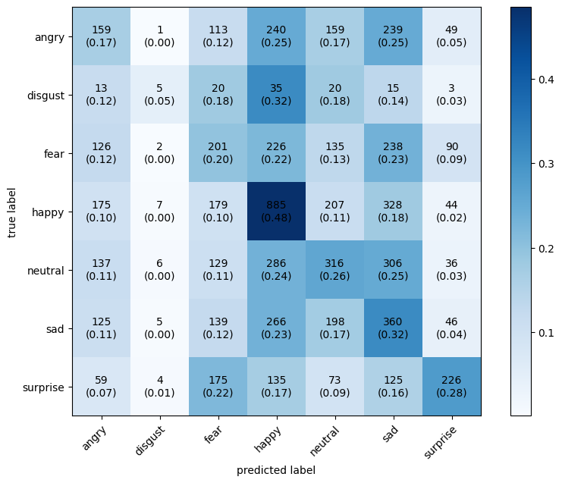
Entropy Based Sampling

Slide 102
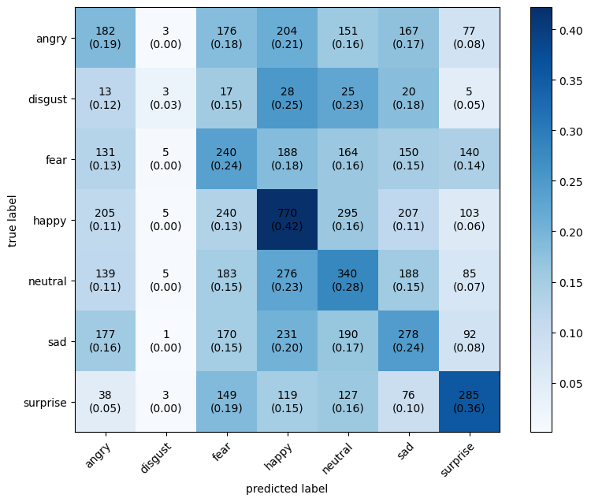
Margin Sampling

Slide 103
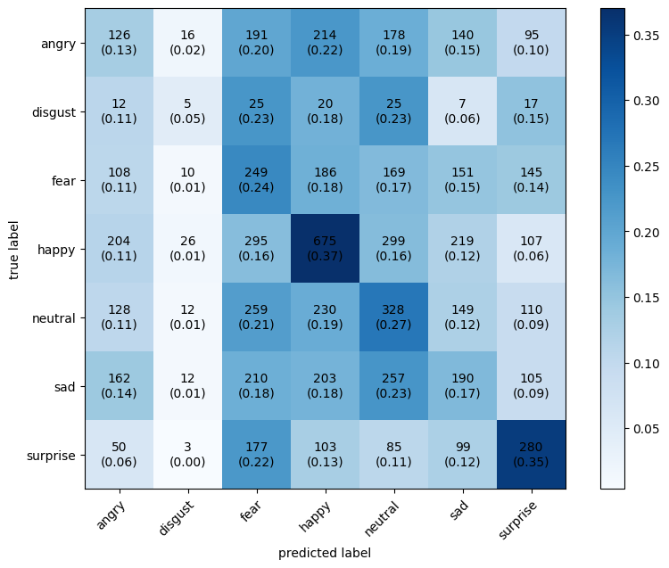
Random Sampling

Slide 104

Uncertainty Sampling

Slide 105

Query By Committee

Slide 106
05
Notes and Challenges

Slide 107

Notes and Challenges

Slide 108
06
Additional Improvements done

Slide 109
No Improvements!

Slide 110
Team Members
Youssef Mohammed
Abdelrahman Mostafa
Mohammed Hisham
Abdelrahman Amin

Slide 111
Thanks!

